Slide 1
CITY OF RIVERSIDE PERMIT PORTAL
HOW TO SUBMIT A
FIRE PERMIT

Slide 2
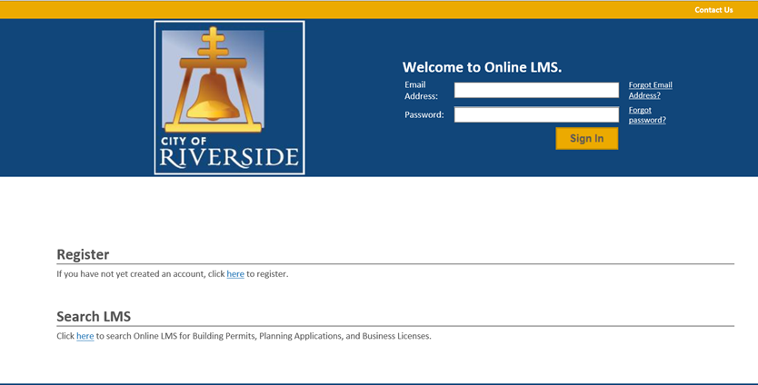
HOW TO SUBMIT A FIRE PERMIT
If you are a NEW USER, you will need to set up a new user login in the system in order to access your activities
If you are a RETURNING USER, sign in using your email address and password
Once registered, ensure you sign up for email notification for real time status updates under your “Profile” at the top right of the home screen

Slide 3
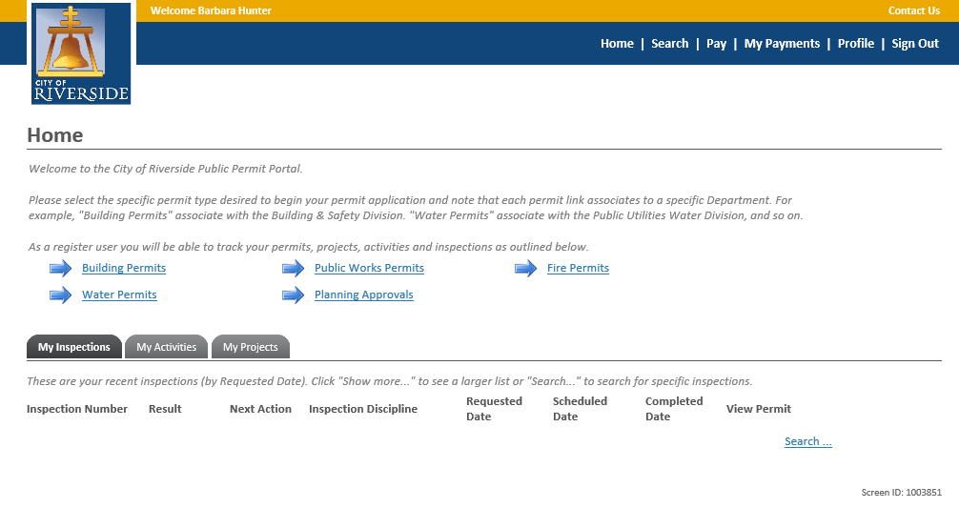
HOW TO SUBMIT A FIRE PERMIT
To submit a FIRE PERMIT APPLICATION, begin at the HOME page and click on FIRE PERMITS

Slide 4
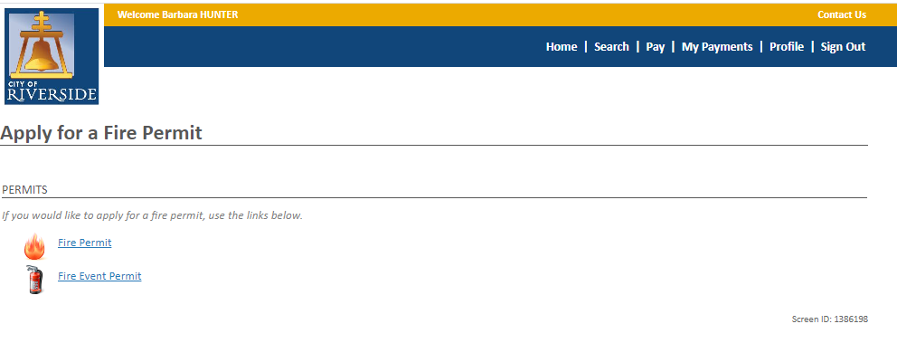
HOW TO SUBMIT A FIRE PERMIT
Next, select FIRE PERMIT

Slide 5
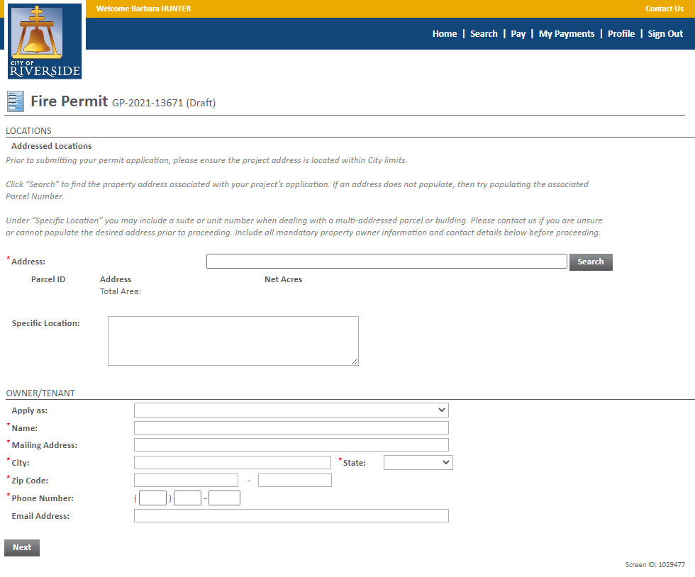
HOW TO SUBMIT A FIRE PERMIT
Enter the ADDRESS where the project is located.
You may also search by Parcel Number
Click SEARCH ( follow next steps on the pop-up window)
Check the box Address / Parcel where the project is located
Click Select
Enter the OWNER/TENANT information. Note: The Owner/Tenant may be the same as the applicant submitting the Fire Permit
Click NEXT

Slide 6
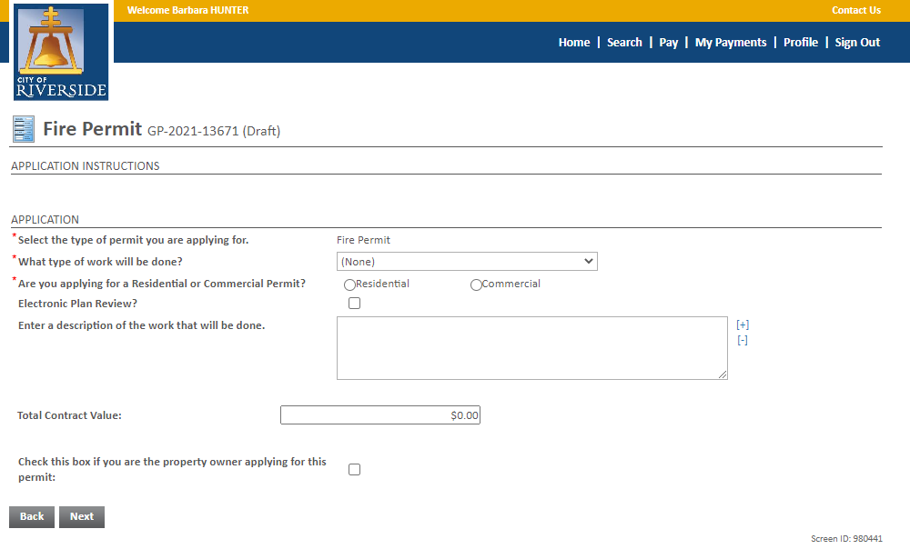
HOW TO SUBMIT A FIRE PERMIT
Click the dropdown to select the type of PERMIT you are submitting.
Check the box for the type of permit - RESIDENTIAL or COMMERCIAL
Check Electronic Plan Review
Enter a description of the project that is being submitted. Please be brief but descriptive.
Check box if you are property owner
Click NEXT to continue

Slide 7
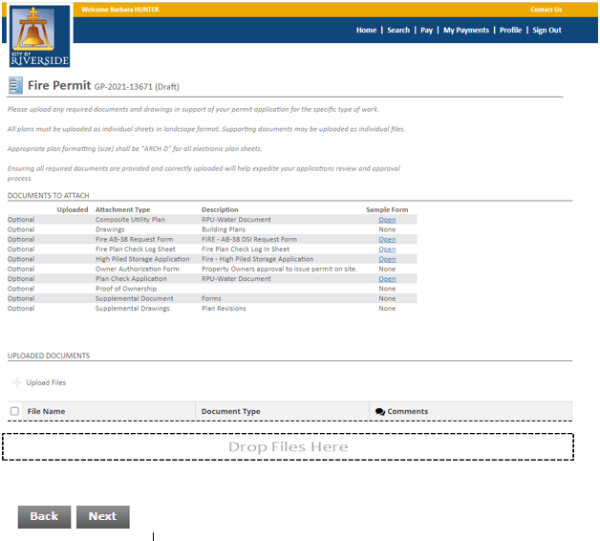
HOW TO SUBMIT A FIRE PERMIT
Select the required FIRE PLAN CHECK LOG SHEET. Complete Form and save to your computer to upload into Posse.
If you are submitting for a High Pile Storage Permit, Complete the required High Pile Storage Application in addition to the Fire Plan Check Log Sheet.
Click UPLOAD FILES to upload all required & supplemental documents from your File Explorer or, you may drag and drop selected files in the section below marked DROP FILES HERE.
Once documents are uploaded, select DOCUMENT TYPE from dropdown menu.
When complete, click NEXT.

Slide 8
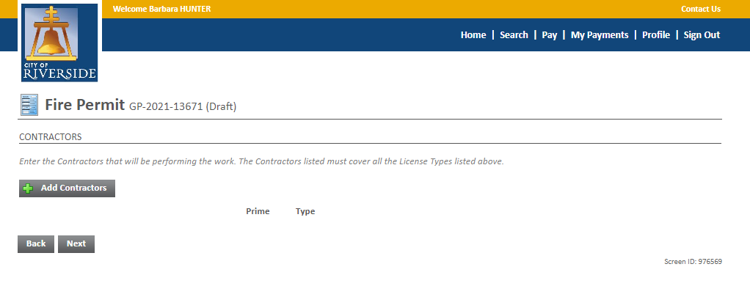
HOW TO SUBMIT A FIRE PERMIT
Click ADD CONTRACTORS
Enter Business Name
Select Search ( follow next steps on the pop-up window)
Select your contractor
Click Select
Click the Prime box
Select the Type of contractor from the drop-down menu
Click Next

Slide 9
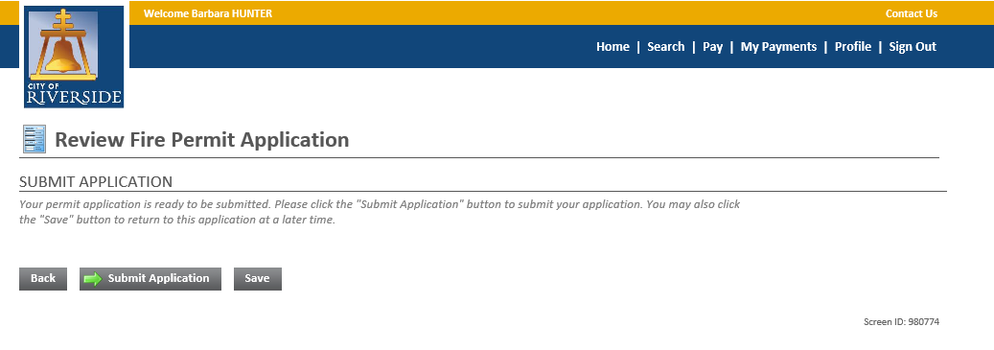
HOW TO SUBMIT A FIRE PERMIT
Your application is now ready to submit.
You may use the BACK button to review your application or add any missing information.
You may click SAVE to save without submitting.
Click SUBMIT APPLICATION to complete the process. You will receive a confirmation of the receipt of your permit application.

Slide 10
CITY OF RIVERSIDE PERMIT PORTAL
THANKS FOR
WATCHING!
FOR FURTHER ASSISTANCE, CONTACT THE CITY OF RIVERSIDE ONE STOP SHOP 951-826-5800

